Slide 1

Kahaila Brick Lane
Wednesday 7th April
Palm Sunday – John 12:12-19

Slide 2
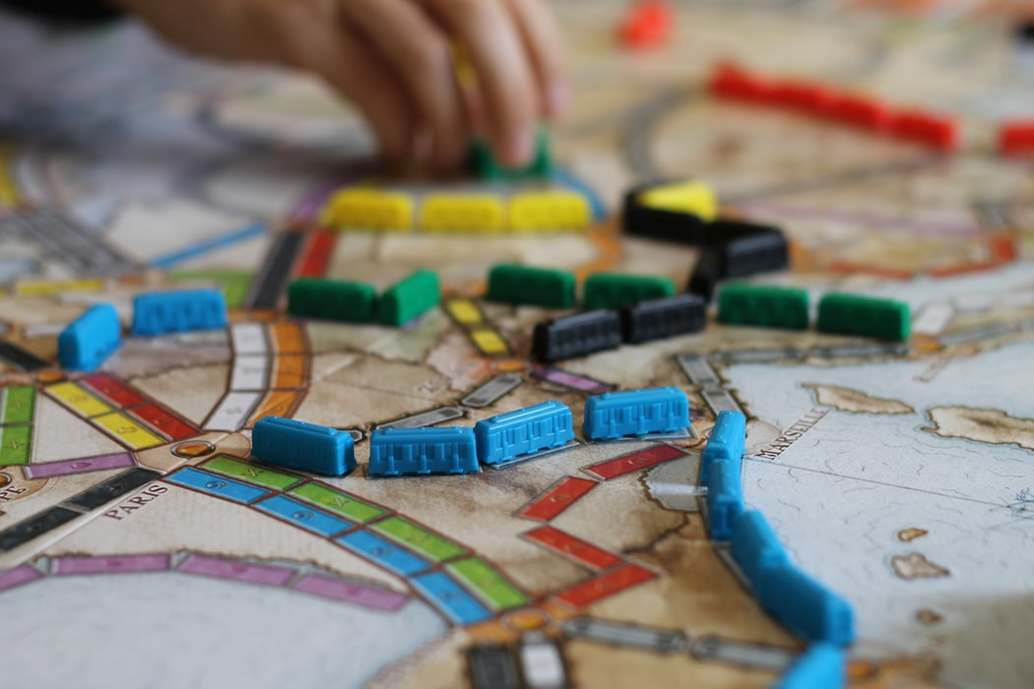
Notices:
Essence Virtual Quiz – moved to next Tuesday at 7pm
Good Friday Reflection – Friday at 10am
Easter Sunday Service – Sunday at 11am
Immerse – Sunday at 9:30pm
Socials – board games, film club, cooking classes

Slide 3
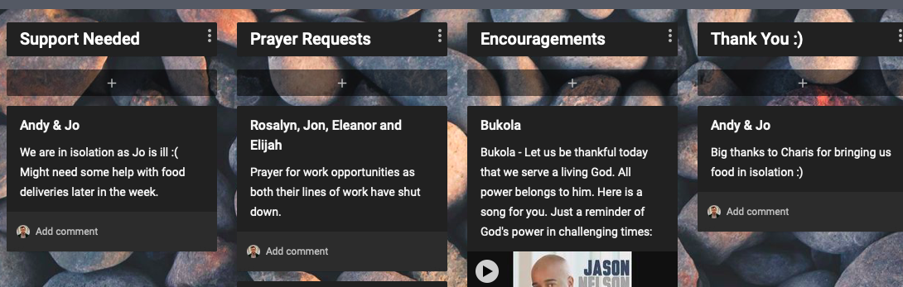
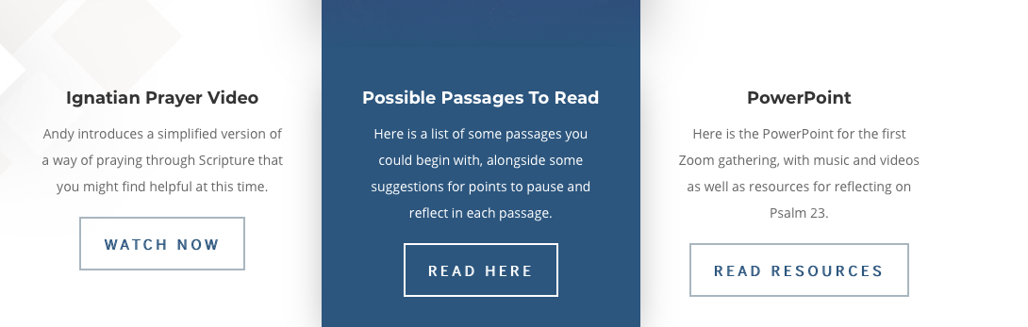
Notices:
Add prayers, support or encouragement to our community notice board. Link in chat.
Listen/watch back talks and find resources on our website.
Link in chat.

Slide 4
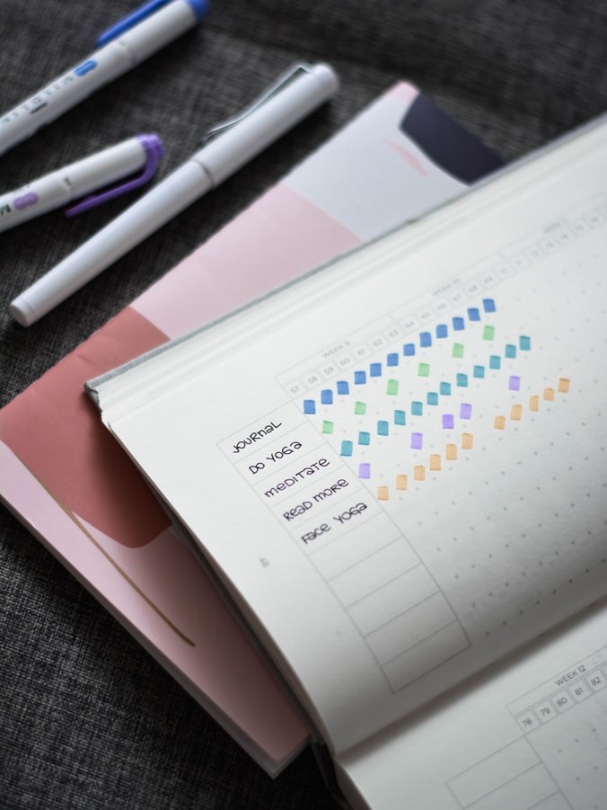

Sharing Ideas:
Have you found anything particularly helpful in your spiritual walk during this season?

Slide 5
Testimonies:
A time to share stories of encouragement, of where God has been at work, to maintain a grateful heart

Slide 7
My Jesus, my Saviour
Lord there is none like You
All of my days I want to praise
The wonders of Your mighty love
My comfort, my shelter
Tower of refuge and strength
Let every breath, all that I am
Never cease to worship You

Slide 8
Shout to the Lord all the Earth, let us sing
Power and majesty, praise to the King
Mountains bow down and the seas will roar
At the sound of Your name
I sing for joy at the work of Your hand
Forever I'll love You, forever I'll stand
Nothing compares to the promise I have
In You

Slide 9
So I'll stand
With arms high and heart abandoned
In awe of the One who gave it all
So I'll stand
My soul Lord to You surrendered
All I am is Yours

Slide 11
You Deserve It
My Hallelujah belongs to you
My Hallelujah belongs to you
My Hallelujah belongs to you
My Hallelujah belongs to you

Slide 12
You deserve it
You deserve it
You deserve it
You deserve it

Slide 13
All of the Glory belongs to you
All of the Glory belongs to you
All of the Glory belongs to you
All of the Glory belongs to you

Slide 14
Hallelujah
Hallelujah
Hallelujah
Hallelujah
All the Glory
All the Honour
All the Praise

Slide 16
God, I Look to You
God, I look to You, I won't be overwhelmed
Give me vision to see things like You do
God I look to You, You're where my help comes from
Give me wisdom, You know just what to do

Slide 17
And I will love You, Lord, my strength
I will love You, Lord, my shield
I will love You, Lord, my rock forever
All my days I will love You, God

Slide 18
Hallelujah, our God reigns
Hallelujah, our God reigns
Hallelujah, our God reigns
Forever, all my days, Hallelujah

Slide 20

Jesus Comes to Jerusalem as King
¹² The next day the great crowd that had come for the festival heard that Jesus was on his way to Jerusalem. ¹³ They took palm branches and went out to meet him, shouting,
“Hosanna!”
“Blessed is he who comes in the name of the Lord!”
“Blessed is the king of Israel!”
¹⁴ Jesus found a young donkey and sat on it, as it is written:
¹⁵ “Do not be afraid, Daughter Zion; see, your king is coming, seated on a donkey’s colt.”
¹⁶ At first his disciples did not understand all this. Only after Jesus was glorified did they realize that these things had been written about him and that these things had been done to him.
¹⁷ Now the crowd that was with him when he called Lazarus from the tomb and raised him from the dead continued to spread the word. ¹⁸ Many people, because they had heard that he had performed this sign, went out to meet him. ¹⁹ So the Pharisees said to one another, “See, this is getting us nowhere. Look how the whole world has gone after him!”
John 12:12-19

Slide 21
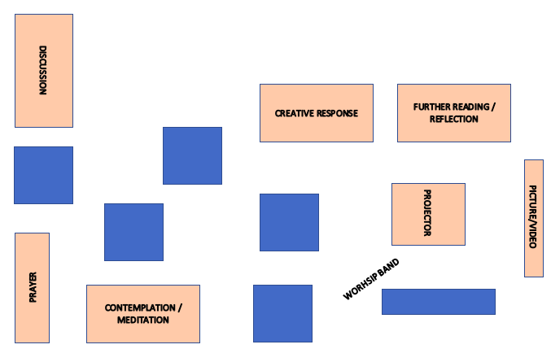
Engage
John 12:12-19

Slide 22
John 12:12-19
Jesus Comes to Jerusalem as King
¹² The next day the great crowd that had come for the festival heard that Jesus was on his way to Jerusalem. ¹³ They took palm branches and went out to meet him, shouting,
“Hosanna!”
“Blessed is he who comes in the name of the Lord!”
“Blessed is the king of Israel!”
¹⁴ Jesus found a young donkey and sat on it, as it is written:
¹⁵ “Do not be afraid, Daughter Zion;
see, your king is coming,
seated on a donkey’s colt.”
¹⁶ At first his disciples did not understand all this. Only after Jesus was glorified did they realize that these things had been written about him and that these things had been done to him.
¹⁷ Now the crowd that was with him when he called Lazarus from the tomb and raised him from the dead continued to spread the word. ¹⁸ Many people, because they had heard that he had performed this sign, went out to meet him. ¹⁹ So the Pharisees said to one another, “See, this is getting us nowhere. Look how the whole world has gone after him!”
Discuss:
What comes to mind when you hear the word salvation?
What do you think other people think when they hear the word?
How could this salvation be a present reality for people today?
How can we partner with God to bring this message of hope?
Create:
Create your own palm leaves with phrases of praise or prayers to God.
Contemplate:
Liturgists Holy Week Liturgy HERE
Scattered Palms Poem HERE
BBC Palm Sunday Service HERE
Explore:
Bible Project –Gospel of the Kingdom
Tom Wright and Zechariah 9

Slide 23
Sharing:
What are your reflections on the passage?

Slide 24
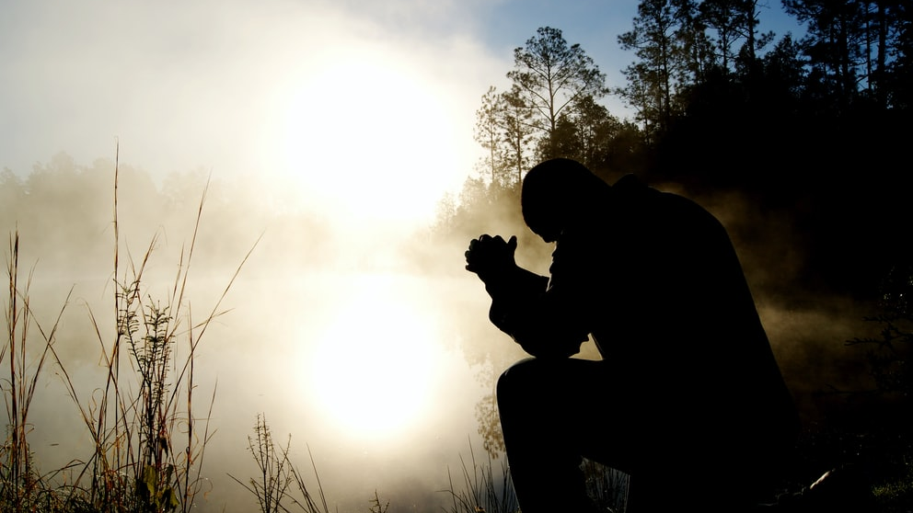
Prayers

Slide 25
Our father who dwells in the heavens and on the earth, you are holy.
May heaven be a greater present reality here on earth,
And may we choose to join you in making that happen.
Provide us today with the things that you think we need,
And may we not take for granted that which you have already provided.
Forgive us when we don’t live as you intend,
And may we be ready to forgive others when they don’t live as we intend.
Guide us in your wisdom away from the things that would distort us,
And restore the parts in us that are already distorted.
You are goodness, beauty and truth. May your love rule always
Amen

Slide 26
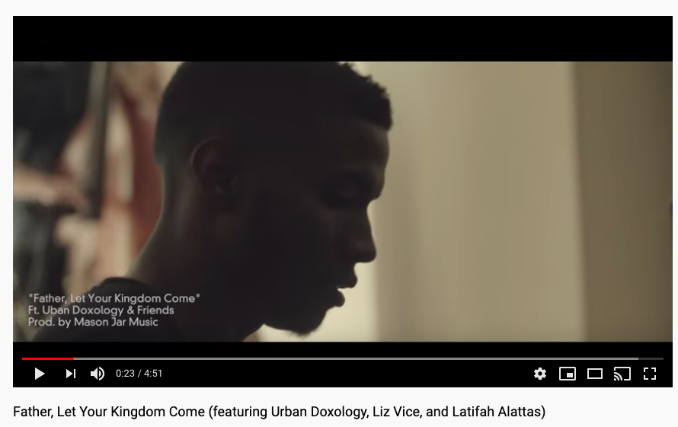

Slide 27
Final Blessing:
May the blessing of God who resides in our hopes and our dreams grant us peace.
May the blessing of Jesus Who rides to wild acclaim and waving palm branches grant us peace.
May the blessing of the Spirit Who holds us through our fears and our nightmares grant us peace…
…on this Palm Sunday through the events of Holy Week to the cross of Good Friday and beyond to look for the hopes and dreams of the dawning of an Easter Morning.
Amen

Slide 28
Lord’s Prayer:
Our Father in heaven,
hallowed be your name,
your kingdom come,
your will be done,
on earth as in heaven.
Give us today our daily bread.
Forgive us our sins as we forgive those who sin against us.
Lead us not into temptation but deliver us from evil.
For the kingdom, the power, and the glory are yours, now and for ever.
Amen.

