Slide 1
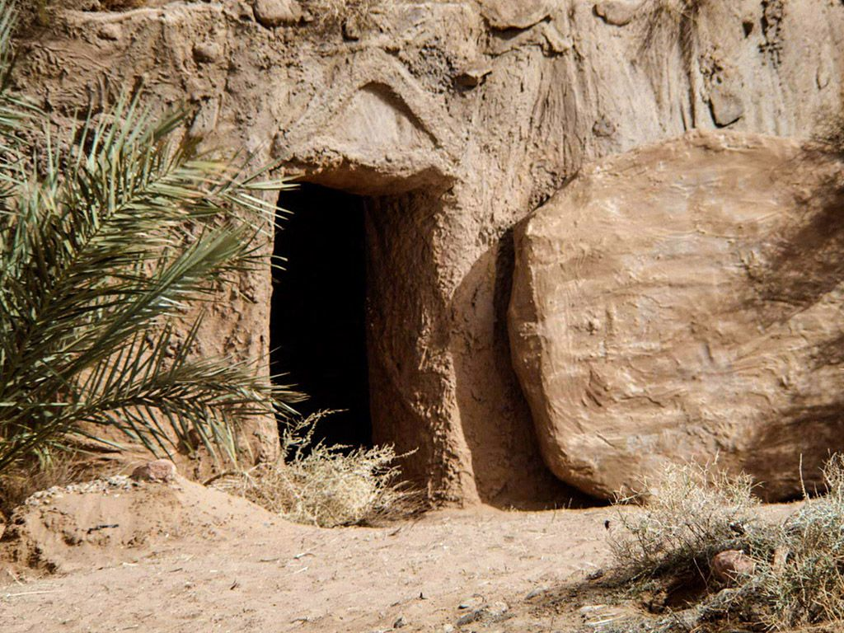

Easter Sunday Service

Slide 3
Lord I lift your name on high
Lord I love to sing your praises
I'm so glad you are in my life
I'm so glad you came to save us

Slide 4
You came from heaven to earth, to show the way
From the earth to the cross, my debt to pay
From the cross to the grave, from the grave to the sky
Lord I lift your name on high

Slide 6
He has Risen
He has risen
He has risen
He has risen
Jesus is alive

Slide 7
When the life flowed from His body
Seemed like Jesus' mission failed
But His sacrifice accomplished
Victory over sin and death

Slide 8
He has risen
He has risen
He has risen
Jesus is alive

Slide 9
If there were no resurrection
We ourselves could not be raised
But the son of God is living
So our hope is not in vain

Slide 10
He has risen
He has risen
He has risen
Jesus is alive

Slide 11
He has given life immortal
We shall see Him face to face
Through eternity we'll praise Him
Christ the champion of our faith

Slide 12
He has risen
He has risen
He has risen
Jesus is alive

Slide 15
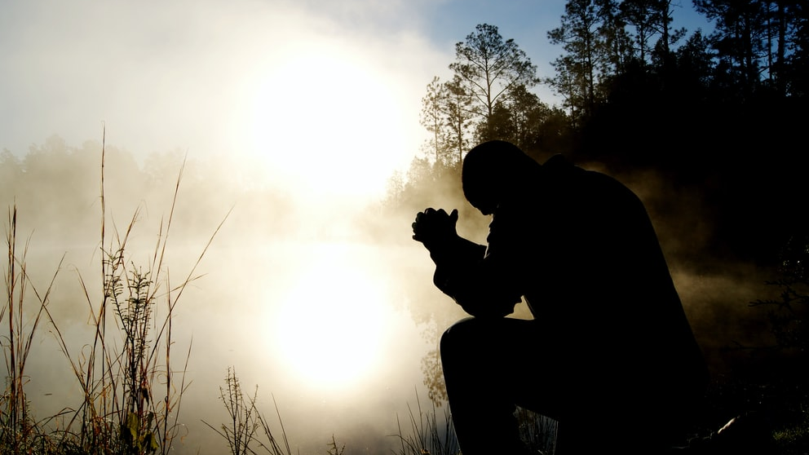
Prayers

Slide 17
John 20:19-23
Jesus appears to his disciples
¹⁹ On the evening of that first day of the week, when the disciples were together, with the doors locked for fear of the Jewish leaders, Jesus came and stood among them and said, “Peace be with you!” ²⁰ After he said this, he showed them his hands and side. The disciples were overjoyed when they saw the Lord.
²¹ Again Jesus said, “Peace be with you! As the Father has sent me, I am sending you.” ²² And with that he breathed on them and said, “Receive the Holy Spirit. ²³ If you forgive anyone’s sins, their sins are forgiven; if you do not forgive them, they are not forgiven.”

Slide 19
History
What does it mean to you to know that this resurrection story is true?
Jesus came and stood among them and said, “Peace be with you!” (v19)
The disciples were overjoyed when they saw the Lord. (v20)

Slide 20
Hope
What comes to mind when you hear the word hope?
‘He will wipe every tear from their eyes. There will be no more death or mourning or crying or pain, for the old order of things has passed away.’ (Rev 21:4)

Slide 21
Help
We are not alone
‘we boast in the hope of the glory of God. Not only so, but we also glory in our sufferings, because we know that suffering produces perseverance; perseverance, character; and character, hope. And hope does not put us to shame, because God’s love has been poured out into our hearts through the Holy Spirit, who has been given to us.’
(Romans 5:2-3)
Again Jesus said, ‘Peace be with you! As the Father has sent me, I am sending you.’ And with that he breathed on them and said, ‘Receive the Holy Spirit’ (John 21:21-22)

Slide 23
Here I am to Worship
Light of the world
You stepped down into darkness
Opened my eyes, let me see
Beauty that made this heart adore You
Hope of a life spent with You

Slide 24
Here I am to worship
Here I am to bow down
Here I am to say that You're my God
You're altogether lovely
Altogether worthy
Altogether wonderful to me

Slide 25
King of all days
Oh so highly exalted
Glorious in heaven above
Humbly You came to the earth You created
All for love's sake became poor

Slide 26
Here I am to worship
Here I am to bow down
Here I am to say that You're my God
You're altogether lovely
Altogether worthy
Altogether wonderful to me

Slide 27
Well, I'll never know how much it cost
To see my sin upon that cross
Well, I'll never know how much it cost
To see my sin upon that cross

Slide 29
When I Survey the Wondrous Cross
When I survey the wondrous cross
On which the Prince of glory died,
My richest gain I count but loss,
And pour contempt on all my pride.

Slide 30
Forbid it, Lord, that I should boast,
Save in the death of Christ my God!
All the vain things that charm me most,
I sacrifice them to His blood.

Slide 31
See from His head, His hands, His feet,
Sorrow and love flow mingled down!
Did e’er such love and sorrow meet,
Or thorns compose so rich a crown?

Slide 32
Were the whole realm of nature mine,
That were a present far too small;
Love so amazing, so divine,
Demands my soul, my life, my all.

Slide 34
COMMUNION

Slide 36
Resurrecting
The head that once was crowned with thorns
Is crowned with glory now
The Saviour knelt to wash our feet
Now at His feet we bow

Slide 37
The One who wore our sin and shame
Now robed in majesty
The radiance of perfect love
Now shines for all to see

Slide 38
Your name, Your name
Is victory
All praise, will rise
To Christ, our king

Slide 39
The fear that held us now gives way
To Him who is our peace
His final breath upon the cross
Is now alive in me

Slide 40
Your name, Your name
Is victory
All praise, will rise
To Christ, our king

Slide 41
By Your spirit I will rise
From the ashes of defeat
The resurrected King, is resurrecting me
In Your name I come alive
To declare Your victory
The resurrected King, is resurrecting me

Slide 42
The tomb where soldiers watched in vain
Was borrowed for three days
His body there would not remain
Our God has robbed the grave

Slide 43
Your name, Your name
Is victory
All praise, will rise
To Christ, our king

Slide 44
By Your spirit I will rise
From the ashes of defeat
The resurrected King, is resurrecting me
In Your name I come alive
To declare Your victory
The resurrected King, is resurrecting me

Slide 46
Drumming Celebration

Slide 48
Lord’s Prayer:
Our Father in heaven,
hallowed be your name,
your kingdom come,
your will be done,
on earth as in heaven.
Give us today our daily bread.
Forgive us our sins as we forgive those who sin against us.
Lead us not into temptation but deliver us from evil.
For the kingdom, the power, and the glory are yours, now and for ever.
Amen.

