Slide 1

Kahaila Brick Lane
Wednesday 25th March
Generosity – 2 Corinthians 8

Slide 2
Notices:
We will keep you all informed about developments as an when they happen – through the newsletters, Facebook, Instagram and WhatsApp – please email andy@kahaila.com if you want more info
Paul (07779643160) and Andy (07976477949) are available to chat to and pray with anyone – via phone, skype or zoom
Monday and Friday morning prayer meetings at 9am, Wednesday services at 7pm, Sunday services at 8pm
Essence monthly quiz happening tomorrow night
Lunches for the homeless community

Slide 3
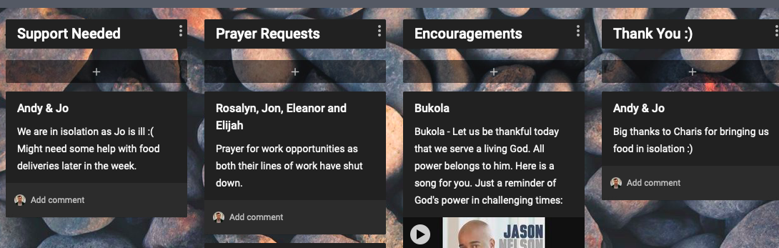
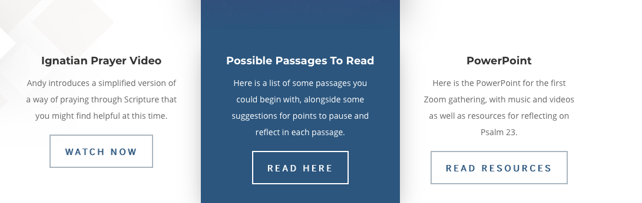
Notices:
Add prayers, support or encouragement to our community notice board. Link in chat.
Listen/watch back talks and find resources on our website.
Link in chat.

Slide 4
Testimonies:
A time to share stories of encouragement, of where God has been at work, to maintain a grateful heart

Slide 5
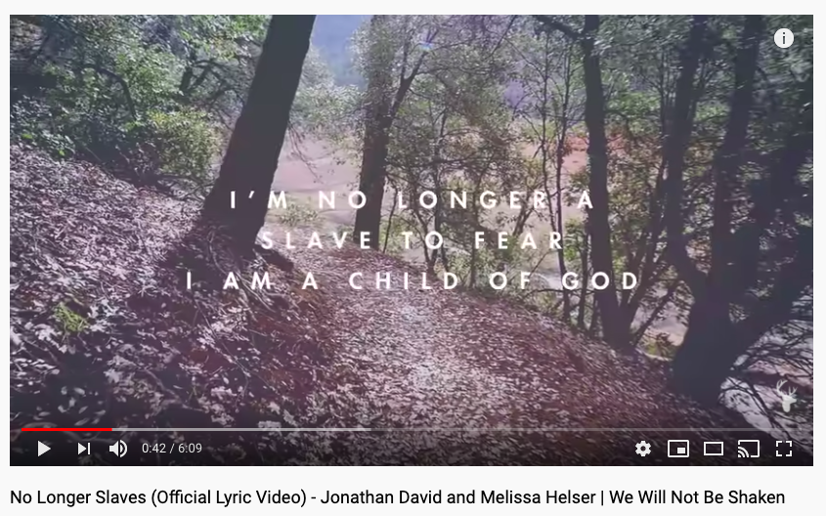

Slide 6
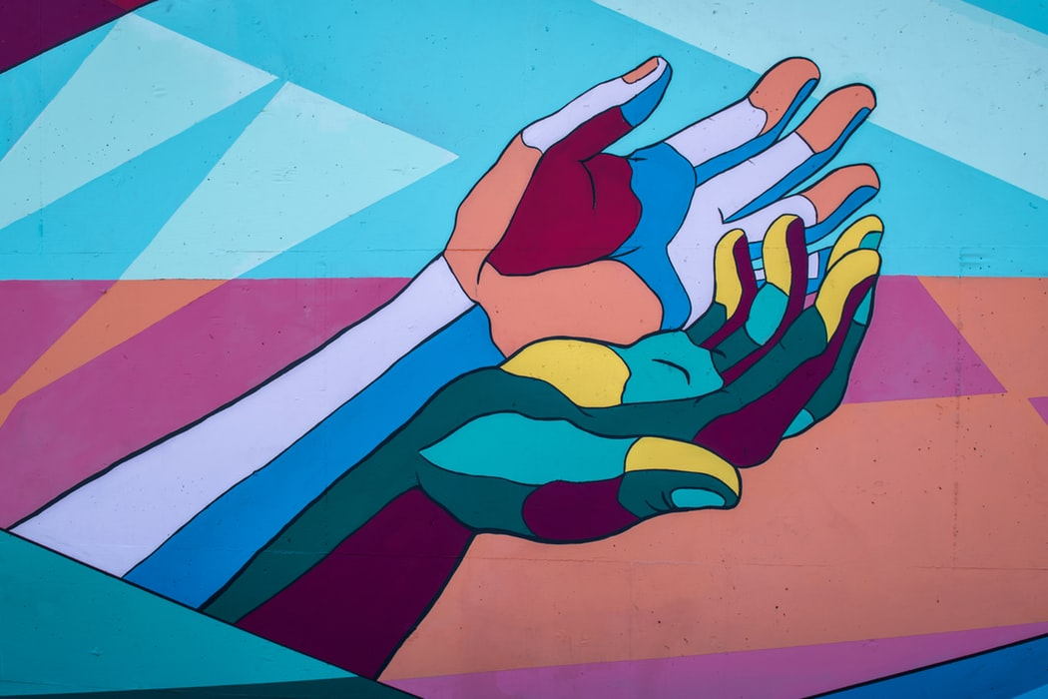
Generosity
2 Corinthians 8:1-15

Slide 7
What kind of church are we called to be?
A church with open hands
A church without fear
A church defined by rich generosity
A church looking at Christ

Slide 8
1) A church with open hands
We need to be willing and open to adapt and change –
to see what God is doing and try to join in

Slide 9

2) A church without fear
“A scared world needs a fearless church”
A W Tozer (American Pastor 1897-1963)

Slide 10
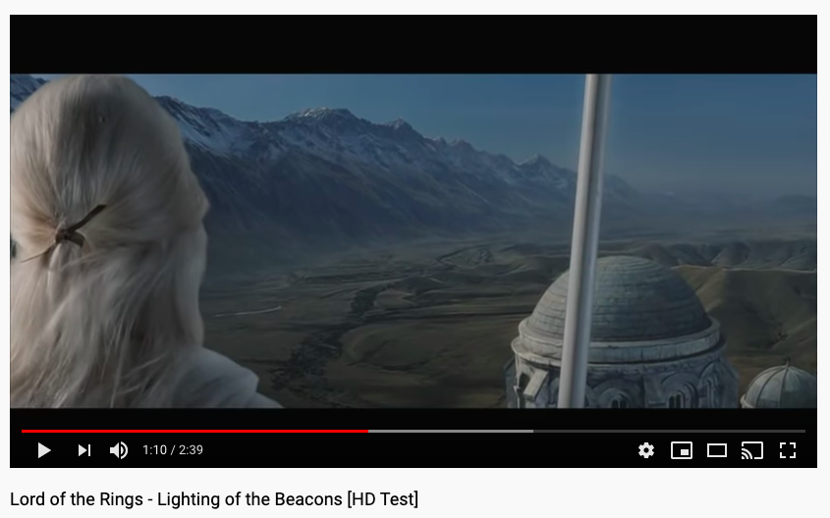

Slide 11
Our life is going to be less characterised by attendance at church on Sunday, and more characterised by the prayer and service we offer each day. We may not be able to pray with people in the ways that we are used to, but we can certainly pray for people. And we can certainly offer practical care and support. Please do carry on supporting the local foodbank and buy extra provisions for it. Ensure the night shelters wherever possible are kept open. There are many very encouraging schemes happening right across our country in communities to focus on caring for the most vulnerable, so do continue to play your part in those. Then by our service, and by our love, Jesus Christ will be made known, and the hope of the gospel – a hope that will counter fear and isolation - will spread across our land.
Archbishop of Canterbury and the Archbishop of York

Slide 12

We believe in generous giving – we want to be generous with all things, our finances, our time and our resources.
3) A church defined by rich generosity
^{Verse 2:} In the midst of a very severe trial, their overflowing joy and their extreme poverty welled up in rich generosity.

Slide 13
4) A church looking at Christ
^{Verse 9:} For you know the grace of our Lord Jesus Christ, that though he was rich, yet for your sake he became poor, so that you through his poverty might become rich.

Slide 14
What kind of church are we called to be?
A church with open hands
A church without fear
A church defined by rich generosity
A church looking at Christ

Slide 15
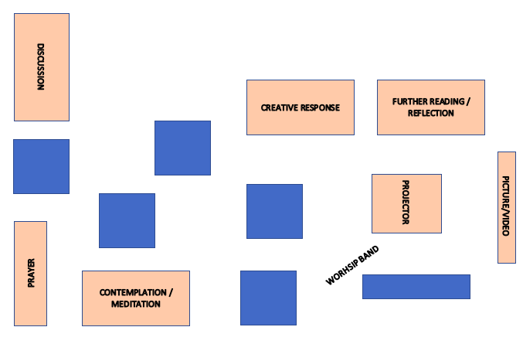
Engage
2 Corinthians 8: 1-15

Slide 16
2 Corinthians 8: 1-15
8 And now, brothers and sisters, we want you to know about the grace that God has given the Macedonian churches. ² In the midst of a very severe trial, their overflowing joy and their extreme poverty welled up in rich generosity. ³ For I testify that they gave as much as they were able, and even beyond their ability. Entirely on their own, ⁴ they urgently pleaded with us for the privilege of sharing in this service to the Lord’s people. ⁵ And they exceeded our expectations: They gave themselves first of all to the Lord, and then by the will of God also to us. ⁶ So we urged Titus, just as he had earlier made a beginning, to bring also to completion this act of grace on your part. ⁷ But since you excel in everything—in faith, in speech, in knowledge, in complete earnestness and in the love we have kindled in you—see that you also excel in this grace of giving.
Discuss:
Have you experienced rich generosity before? How did it feel?
What can we do as a church and as individuals to model this rich generosity at this time?
What do you think Paul means when he talks about being rich?
Create:
Write some letters or notes to hand out to your neighbours to see whether there are things you can do to love them.
Contemplate:
Video on generosity here
Listen to contemplation on generosity here
Explore:
Bible Project - Generosity
Luke 12:22-34 and 1 Timothy 6:17-19

Slide 17
2 Corinthians 8: 1-15
⁸ I am not commanding you, but I want to test the sincerity of your love by comparing it with the earnestness of others. ⁹ For you know the grace of our Lord Jesus Christ, that though he was rich, yet for your sake he became poor, so that you through his poverty might become rich.
¹⁰ And here is my judgment about what is best for you in this matter. Last year you were the first not only to give but also to have the desire to do so. ¹¹ Now finish the work, so that your eager willingness to do it may be matched by your completion of it, according to your means. ¹² For if the willingness is there, the gift is acceptable according to what one has, not according to what one does not have.
¹³ Our desire is not that others might be relieved while you are hard pressed, but that there might be equality. ¹⁴ At the present time your plenty will supply what they need, so that in turn their plenty will supply what you need. The goal is equality, ¹⁵ as it is written: “The one who gathered much did not have too much, and the one who gathered little did not have too little.”
Discuss:
Have you experienced rich generosity before? How did it feel?
What can we do as a church and as individuals to model this rich generosity at this time?
What do you think Paul means when he talks about being rich?
Create:
Write some letters or notes to hand out to your neighbours to see whether there are things you can do to love them.
Contemplate:
Video on generosity here
Listen to contemplation on generosity here
Explore:
Bible Project - Generosity
Luke 12:22-34 and 1 Timothy 6:17-19

Slide 18
Sharing:
What are your reflections on the passage?

Slide 19
Prayer:
Specific prayer requests for our community
  Those who are ill
  Those whose work lives are dramatically changed
  Parents looking after children
  Those working with the most vulnerable
Prayer for our healthcare professionals, for our leaders, for those who are the most vulnerable

Slide 20
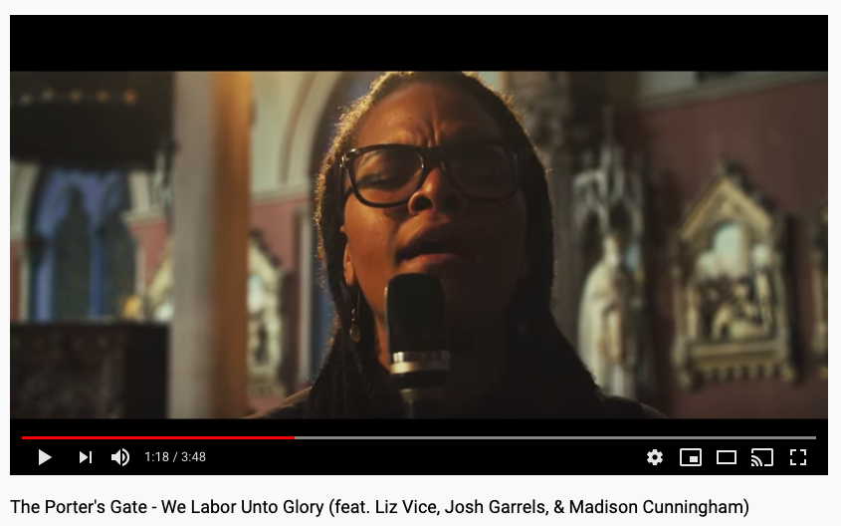

Slide 21
Final Prayer:
We are not people of fear:
we are people of courage.
We are not people who protect our own safety:
we are people who protect our neighbours’ safety.
We are not people of greed:
we are people of generosity.
We are your people God,
giving and loving,
wherever we are,
whatever it costs
For as long as it takes
wherever you call us.
Barbara Glasson, President of the Methodist Conference

Slide 22
Lord’s Prayer:
Our Father in heaven,
hallowed be your name,
your kingdom come,
your will be done,
on earth as in heaven.
Give us today our daily bread.
Forgive us our sins as we forgive those who sin against us.
Lead us not into temptation but deliver us from evil.
For the kingdom, the power, and the glory are yours, now and for ever.
Amen.

